Slide 1
DOM Manipulation
SEI

Slide 2
The What: The Webpage Object
SEI

Slide 3
A Webpage Is One Giant JS Object
Window
Document
Console

Slide 4
Everything you see in the browser is a
JS object.
4 | © 2020 General Assembly

Slide 5
Three Big Objects
Window
Document
Console
The whole web browser; mostly used for browser-level settings.
The current webpage. This object has the functionality we want to use when accessing elements on the page.
A scratch pad for development-related messages; highly useful in debugging.

Slide 6
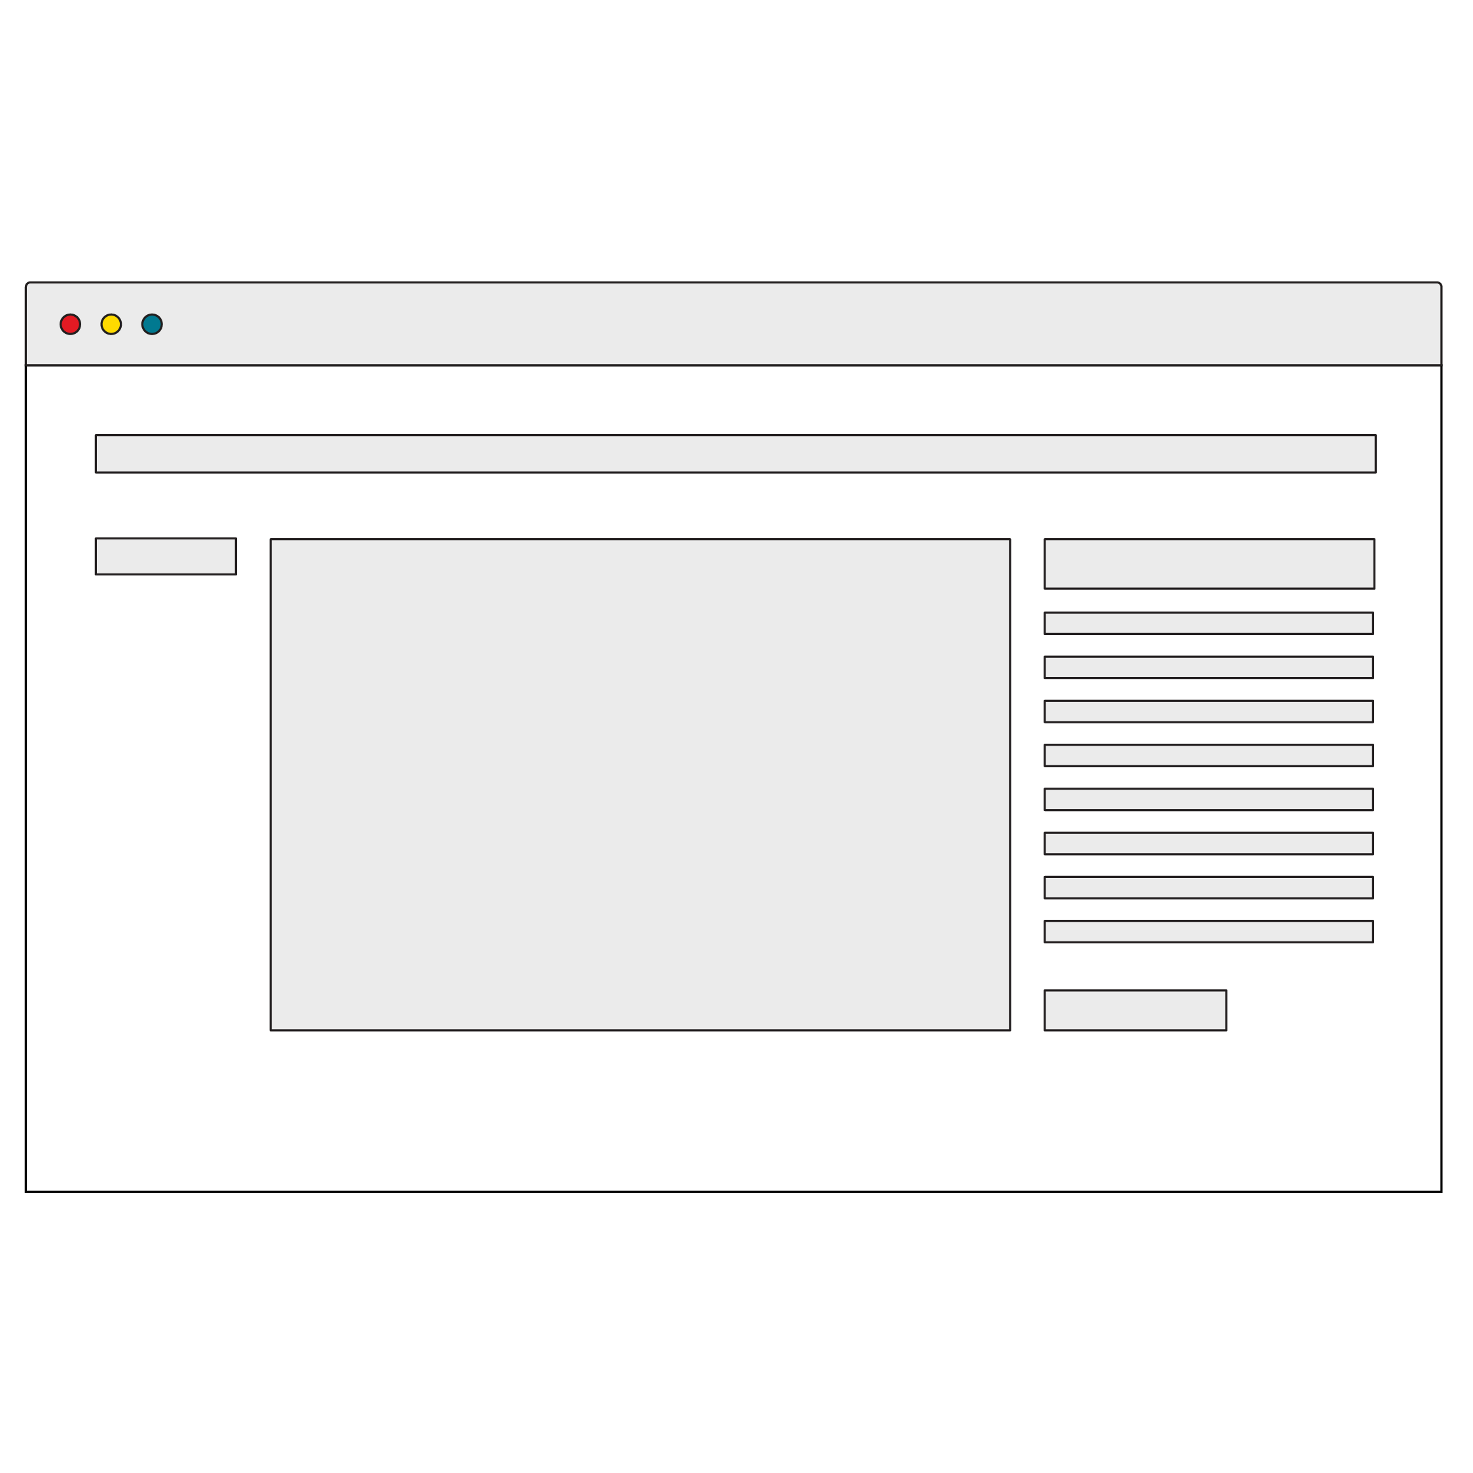
The DOM
Browsers read your HTML and create an object in the computer’s memory for each part. That HTML layout is called a “data model” because it describes the structure of your webpage.
The Document Object Model (DOM) is the browser’s JavaScript representation of your HTML elements.
Notes:
TALKING POINTS:
Open DevTools and type in the word “document” to see what’s returned.

Slide 7
Getters and Setters
The main thing we’re doing with JS is getting objects from the DOM and performing actions with them (moving, hiding, etc).
The methods that get something from a webpage are called getters.
The methods that change something on the webpage are called setters.

Slide 8
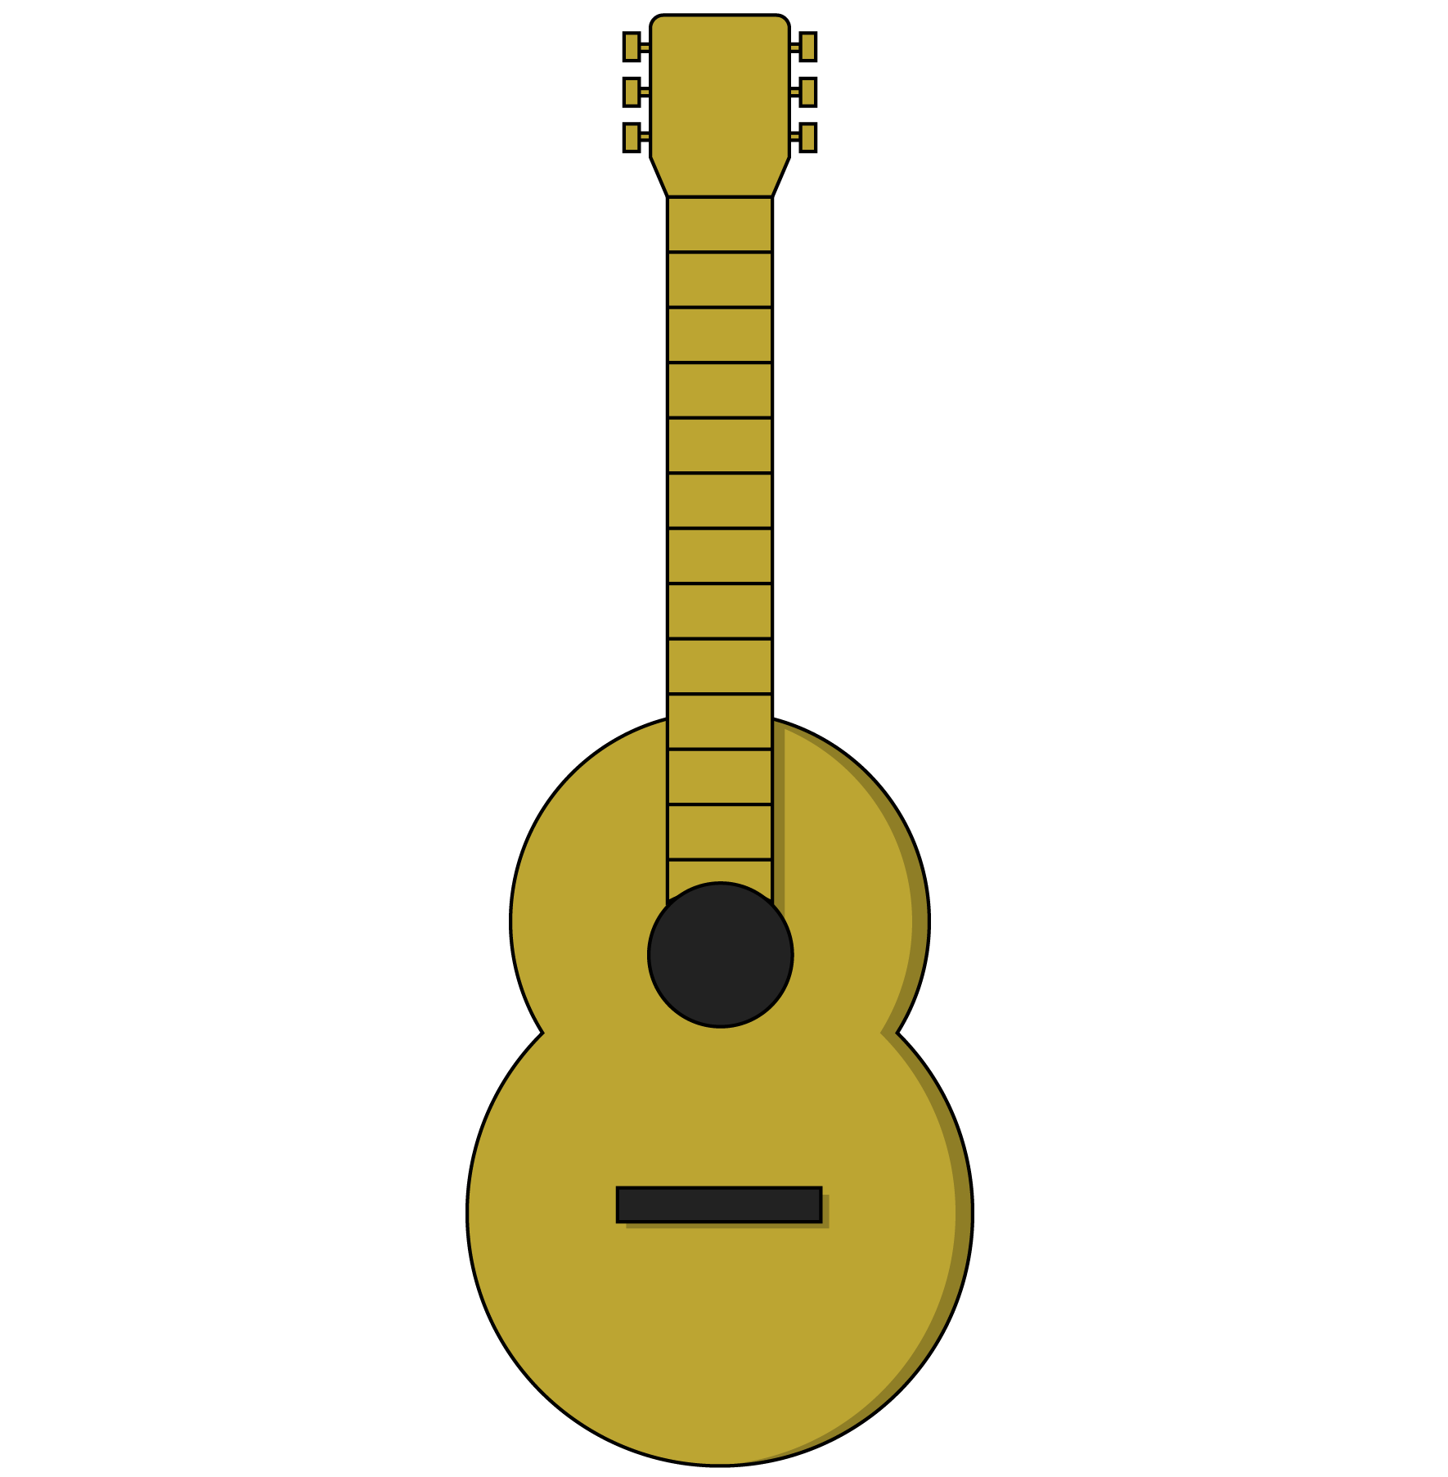
Methods
Getters and setters access and modify objects. They are both types of methods. Methods belong to JavaScript objects, including DOM elements.
Think of methods as the functions that an object can use. A guitar, for example, might have the following methods:
guitar.playChord(chord)
guitar.playNote(note)
guitar.changeTempo(tempo)
guitar.changeVolume(volume)

Slide 9
Properties
Objects often have metadata — information that describes the object (height, width, classes, etc). These pieces of information are called properties.
Property | Description
someElement.classList | A list of the classes belonging to a DOM element.
someElement.id | The ID of an element, if it has one.
someElement.style.color | The color of an element’s text.
window.location.href | The window object’s location details, including the page’s href (hypertext reference/URL).
Notes:
TEACHING TIPS:
Students may recognize some as HTML attributes or CSS properties. Emphasize the concept of key:value pairs throughout programming.

Slide 10
What Does a Real Piece of Code Look Like?
document.getElementById(‘ga’);
Object
Method (getter)
Parameter
Notes:
TALKING POINTS:
This gets an element with the ID of ga from the DOM. This would RETURN an object, our DOM element, so that we could then manipulate it.

Slide 11
Getters
Getters often fill in variables in your JS. Once you get something from the DOM, you can use a variable to store it in memory for future manipulation.
const gaData = document.getElementById(‘ga’);
Now that we have our element, gaData, we can access its properties:
gaData.style.color;
gaData.innerText;
gaData.classList;

Slide 12
We’re mostly going to manipulate classes to make things happen on our pages.
12 | © 2020 General Assembly

Slide 13
Manipulating an Element’s Classes
gaData.classList.toggle(‘show’);
Object
Property
Parameter
Method (setter)
This statement takes the ga object, looks at the element’s list of classes, and toggles the show class on or off.
Notes:
TALKING POINTS:
Note that you can combine properties and methods, as properties can have their own methods.

Slide 14
DOM Reference Code
Let’s look at some DOM properties and methods in action! There’s no need to feel overwhelmed by details — the patterns are what matter.
Reference code:
https://drive.google.com/drive/folders/1DcHwmAhyWSrlAbL3vs0kgjvr3TZd75od?usp=sharing
14 | © 2020 General Assembly
Notes:
TEACHING TIPS:
Take your time going through this section. Use it to change stuff around and show students what’s possible.

Slide 15
The When: Event Handling
SEI

Slide 16
Events and Listeners
Anytime a user interacts with a webpage, the browser classifies that action as an event.
In our JS code, we can listen for events in the browser and trigger functions in response using event listeners.
// When object is clicked, the action function is called object.addEventListener(‘click’, action)
Notes:
TALKING POINTS:
Mouse/finger movements on the screen, clicks, hovers, and key presses are all considered events in JavaScript.

Slide 17
Get, Then Listen
We’ll often get an element and then set an event listener on it. Once the event occurs, the listener will execute the function it was given.
const ga = document.getElementById(‘ga’);
function sayHello(){ console.log(“hello!”);
} ga.addEventListener(‘click’, sayHello)
Notes:
TEACHING TIPS:
Emphasize that this is another repeated pattern throughout DOM manipulation; GET the thing we want, then SET some aspect of it according to what we want to do with it.

Slide 18

Events to Listen For
Click is the most common, but what other events might we want to listen for?
Notes:
TEACHING TIPS:
Hopefully answers lead you to some of the following: Hover, keypress, keydown, keyup, focus, scroll, select, submit.
Try testing out some of the most common event types: https://www.w3schools.com/js/js_htmldom_events.asp.

Slide 19
Event Listeners With Selectors
Let’s see how we can attach event listeners by grabbing elements with either class or ID selectors.
Code with class selectors:
https://drive.google.com/drive/folders/1mm1rkPgnUzgDD-NsIHy4lQU-8jCyn9Bb?usp=sharing
Code with ID selectors:
https://drive.google.com/drive/folders/1QiTumxSp4joe6-y93PvTsAx0_xD8G4gv?usp=sharing

Slide 20
Color Switcher
30 minutes
In this exercise, we’ll use our new event-listening skills to create a color switcher!
Bonus: Try adding more switcher elements that change more colors.
Starter code:
https://drive.google.com/drive/folders/1ekSei8Da5QdZRP9iabhoLzYMYYxpiBOL?usp=sharing
Solution code:
https://drive.google.com/drive/folders/1czuJ8b5gjWcC8byLrsaP3_G_0ljtLtbM?usp=sharing

Slide 21
Traffic Light
45 minutes
In this exercise, write JavaScript that uses buttons to control the traffic light. Only ONE color should be active at a time!
Starter code:
https://drive.google.com/drive/folders/1QkYpHVmIRTsHN5zQ_FKr4m3iuum3Jmhp?usp=sharing
Solution code:
https://drive.google.com/drive/folders/1OvbdYhbT93XUGEsOxWyTDCVegC9z2YHJ?usp=sharing
Notes:
TEACHING TIPS:
If you have extra time after this in the class, feel free to use the historical appendix of what makes JavaScript so unique and why it is the way it is...

Slide 22
Key Takeaways
For Next Time
Everything Is JavaScript!
JavaScript Practice!
HTML elements are represented as objects in the DOM.
DOM objects have getters and setters to manipulate properties.
Event listeners attach to objects and use functions to respond to user actions.
We learned a lot of new concepts in this lesson. Next time, we’ll put them into practice.
22 | © 2020 General Assembly

Slide 24
JavaScript Has a Weird History
SEI

Slide 25
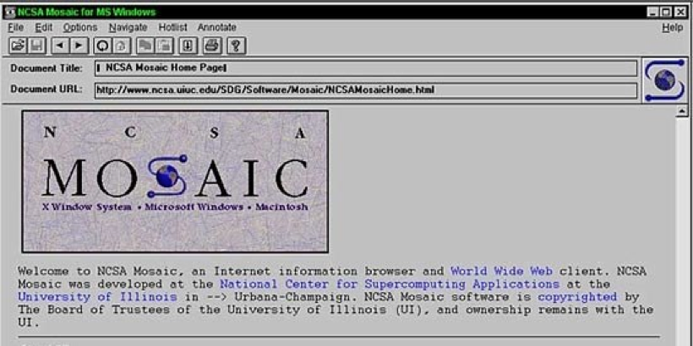
Mosaic: The First Browser
Notes:
TALKING POINTS:
That U.S. National Center for Supercomputing Applications (NCSA) released Mosaic, the first graphical web browser, free of charge. Those engineers would go on to form Mosaic Netscape (codenamed “Mozilla”), and then rename their company Netscape Navigator. It quickly became the default browser for the internet (in the mid-1990s).

Slide 26
Web = Open Platform
From the beginning, the web (which isn’t the same thing as the internet) was conceived as an open medium of exchange. Its architecture assumes good faith on the part of its users, for better or worse.
Notes:
TALKING POINTS:
The web as an open medium of exchange was the basis of this concept. This is very important to understanding why the web is the way it is today. Its builders weren’t typical capitalist-minded business people (at least at first). They saw the world differently, and it’s worth reading more about this history.

Slide 27

The Birth of JavaScript
Brendan Eich developed a programming language for Netscape’s browser in 10 days, which became what is now JavaScript.
Notes:
TALKING POINTS:
Netscape was an innovative early company, which saw the browser as a pay-per-download program — a revolutionary idea at the time. It developed a programmatic language (led by Brendan Eich) for the web as part of its browser called “JavaScript.” It was developed in only 10 days!

Slide 28
The Roaring ’90s
Developers wanted to make this a standard and turned it over to ECMA, a European standards organization.
ECMA came up with ECMAScript 1, 2, and finally version 3 in 1999 — all based off of Netscape's work. Netscape effectively open-sourced JS to the world.

Slide 29
ECMA vs. JS
You'll see ECMAscript and JS used interchangeably a lot online. ECMA is the standards body that controls the baseline actual baseline of JavaScript.
Other languages can be derived from ECMA standards, but JS is far and away the most popular, hence the confusion.

Slide 30
JScript and Internet Explorer
Microsoft, which had developed Windows into a monopoly desktop operating system, saw the popularity of Netscape and tried to reverse engineer how JS worked without given it backward compatibility to Netscape's real version of JS. This led to JScript, a non-compatible JS-like scripting language for Internet Explorer.
Notes:
TALKING POINTS:
Keep the time frame in mind: This is the late 1990s — the internet is not really used at a large scale yet so these decisions have little impact on anyone (the modern equivalent would be what's going on with cryptocurrency now: a major technology without adoption).

Slide 31
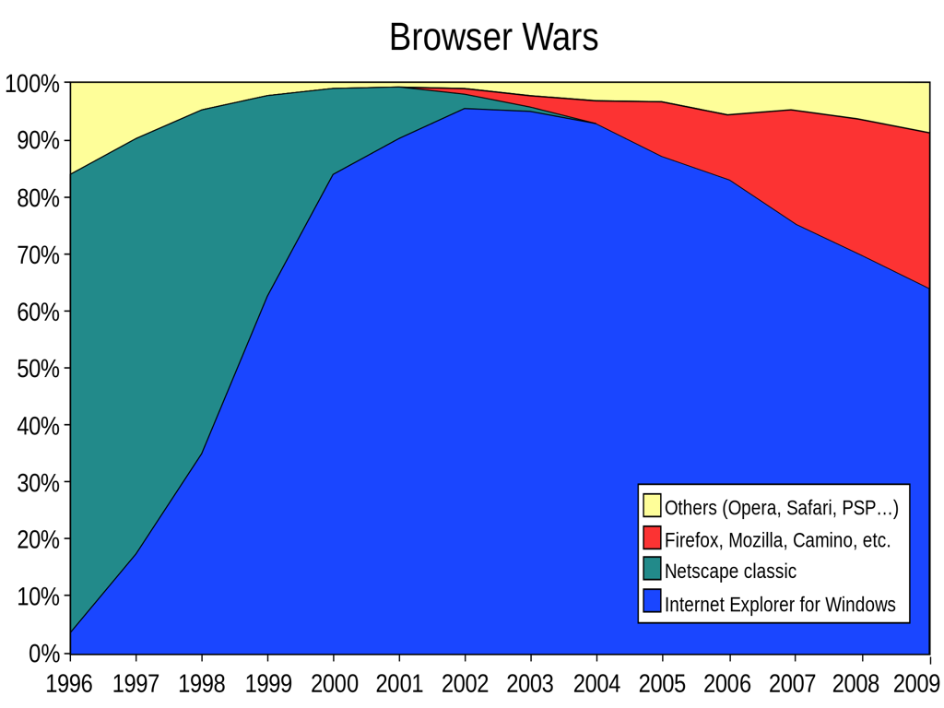
31 | © 2020 General Assembly

Slide 32
IE Takeover
With its monopoly power, MS pushed a free version of IE without JS onto every computer. This significantly set the internet back.
A broad-scale tech industry war broke out as Microsoft destroyed Netscape and assumed the position as the only browser vendor in the early 2000s. Microsoft faced anti-monopoly legislation for doing this but the court case took a LONG time.

Slide 33
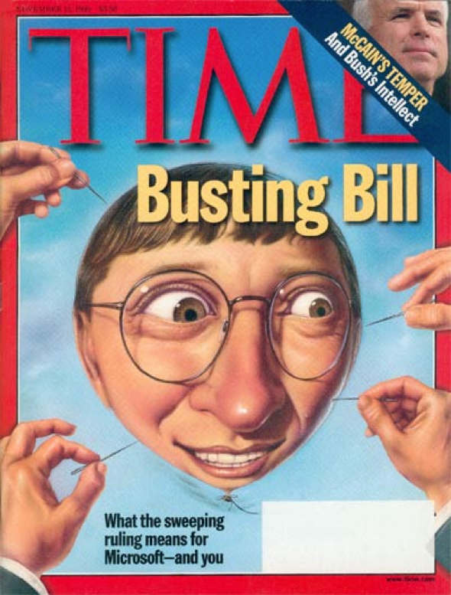
33 | © 2020 General Assembly

Slide 34
The Dark Ages
Early–mid-2000s
This was a dark period for the internet. There wasn't a scripting language standard, and major work around JS stopped at ECMA because of disagreements between major vendors.
The end result was that programs couldn’t really be programs on the internet because they were missing functional pieces browsers didn't have (Microsoft actively wanted the web to stay small so it wouldn't impact its desktop monopoly).

Slide 35
Open Source Rises
The open-source community began to try to overcome the IE monopoly.
Netscape's core code was open-sourced under the original codename “Mozilla” and then eventually Mozilla Firefox in 2005.

Slide 36
jQuery to the Rescue!
The real tipping point was the most ingenious solution to the IE compatibility issues: John Resig reverse-engineered how JavaScript operated and then made a new JS-like, open-source language that worked on every browser, including IE.
It was called jQuery and took off around 2006–2007.

Slide 37
JS Standardizes
2008 saw Google Chrome released, which followed in the footsteps of Firefox — both championing a singular version of JS. 2009 saw the reemergence of ECMA group, rebranding ECMAScript to Version 5.
This is when the internet exploded with possibilities (we’re living in the result).

Slide 38
Finally, Real JS
Now, Mozilla and Chrome pushed a singular version of JS for the first time. It would take Microsoft many years to admit defeat and join the standard, but by around 2013–2014, a common-form of JS would work in every browser (ES5) with the release of the last version of IE (Version 11).

Slide 39
ES6+
2015 saw the release of ES6, which was a dramatic expansion of the baseline JS toolkit, and it was taken up rapidly by all browser vendors.
There is now a yearly release of JS that adds new features (called ESYYYY — so, like ES2020).

Slide 40
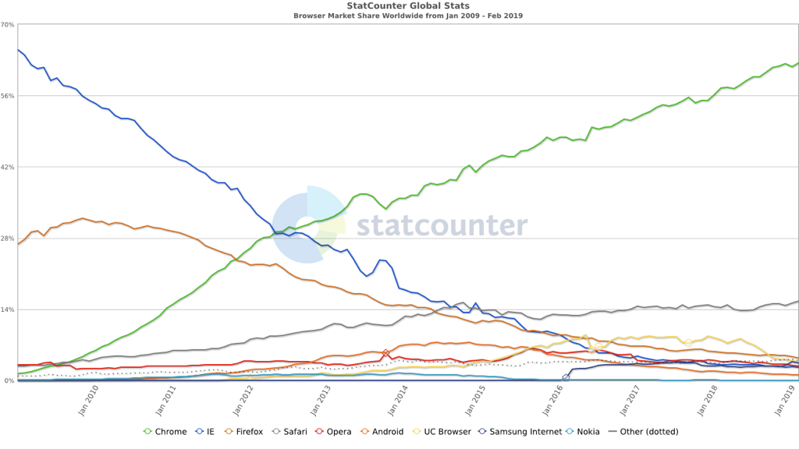
Browser Share

Slide 41
What Makes JS Special?
It has overcome a ridiculous history.
All programming languages require code to be compiled before viewing.
JavaScript is unique because its compiler is your browser, so you can see your work immediately.

